Slide 1
Lunch Price Prediction
Should you get MealPal?
Notes:
Hi Everyone, today I will be speaking about my project Lunch Price Prediction. Also known as Should you get Meal Pal?

Slide 2
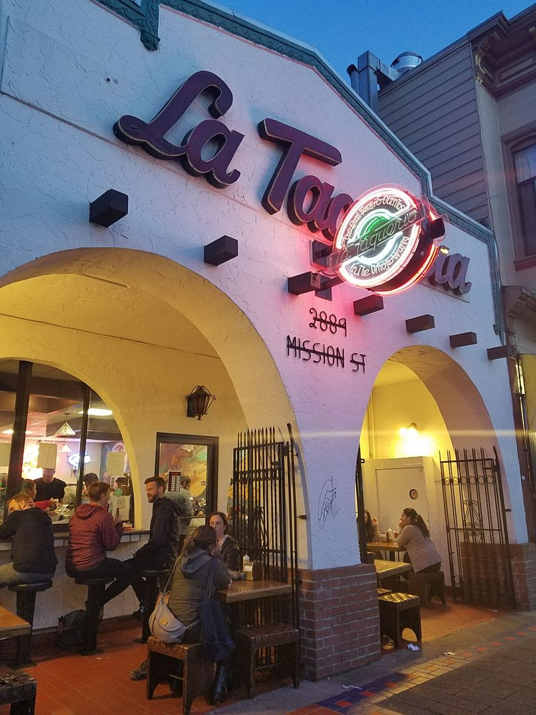
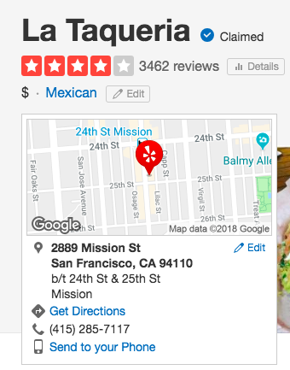
Notes:
One day you are sick of ordering from meal pal, sick of bastardized burritos with raw fish, and want real mexican food.
Go on yelp, you find la taqueria, the home of the mission style burrito in SF.
As you can see very highly rated on yelp.
So you head over and see the nice historical building

Slide 3
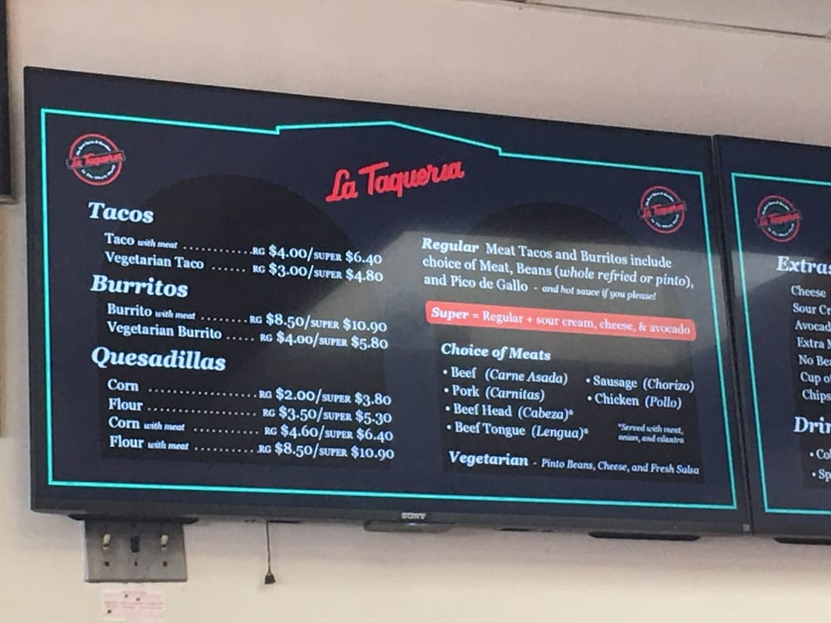
Notes:
Once inside, you look at the menu and are like wow a regular carne asada burrito for 8.5? It’s just a tortilla, steak, hot sauce, and rice, you don’t even get avocado or cheese!
Are they just trying to rip you off and charge more based on their reputation, or is this an appropriate price based off the ingredients they use and the location?

Slide 4



Sources of Information
Restaurant Menus
1000+ restaurants from SF gathered
Ingredient List
Compiled from bbc.com/food and foodwise
Demographic Information
2016 ACS and Economic Census from US Census
Notes:
To build the model I needed data on many different dishes
Scrapped allmenus.com to get the restaurant menus of 1000+ restaurants
From the menus I was able to get food related data like prices and dish titles and descriptions.
Also able to get address and geocoordinates of each restaurant
With dish text I would need to cross reference with a base ingredient list to determine which words were actual ingredients, to do this I scraped two websites bbc and foodwise
Wanted to see if there was correlation between the demographics of the neighborhood that each restaurant lived in and dish price. Incorporated data from 2016 American Community Survey and Economic Census from the US Census Bureau

Slide 5
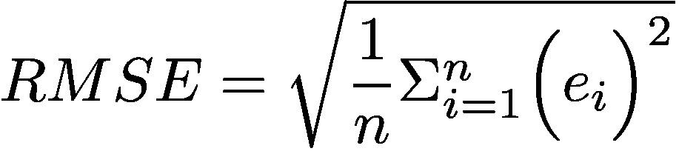
Minimization Metric
Notes:
When building my model the metric that I wanted to minimize was RMSE or root mean square error. This was because RMSE would translate to +/- the amount of money I was off by in each dish price that I was predicting.

Slide 6
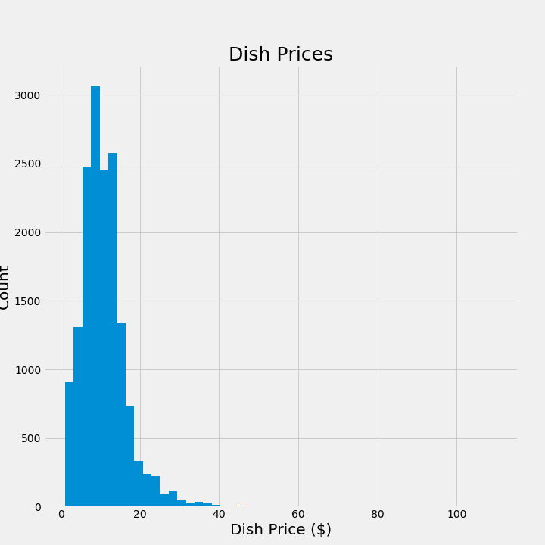
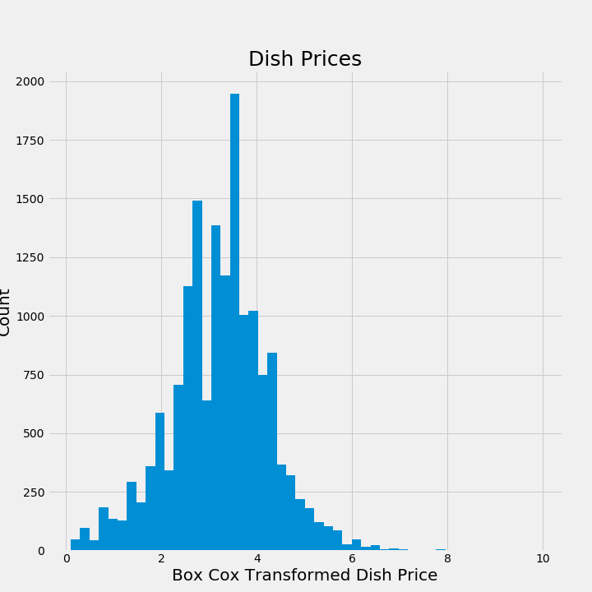
Model Building
Improvements
Boxcox Transformation
Ridge Regression
Prices only between $7 and $20
Notes:
In experimenting with my OLS model there were three improvements I was able to make that had a large improvement to my RMSE:
As shown in the histograms, original pricing data was very skewed. Utilizing a boxcox transformation helped to normalize that
Ridge regression was utilized to regularize and help promote certain features as I had a large number of features in my model
Model having issues with very cheap and expensive dishes, so pricing data was paired down from the larger data set to only include dishes between $7 and $20. Reduced RMSE by 42%
Still had over 10000 pricing data points

Slide 7
Features
Positive Features | Negative Features | Irrelevant Features
Expensive Ingredients | Cheap Ingredients | Geocoordinates
Dish Text Length | Restaurant Types | Demographic Data
Notes:
Final Model Important Features
For positive predictors, expected was expensive ingredients like crab, lobster, duck
Unexpected was dish text length, where there was a positive association with the log of the dish text length squared. More expensive restaurants embellish dish descriptions
For negative predictors, expected was cheap ingredients like cocoa and bagels
There were also two restaurant types that stuck out for cheaper dishes: jerk and mexican
In terms of irrelevant features both geolocation and demographic data like average annual payroll and number of people employed in the food service industry were quickly dropped from the model.
Model Performance:

Slide 8
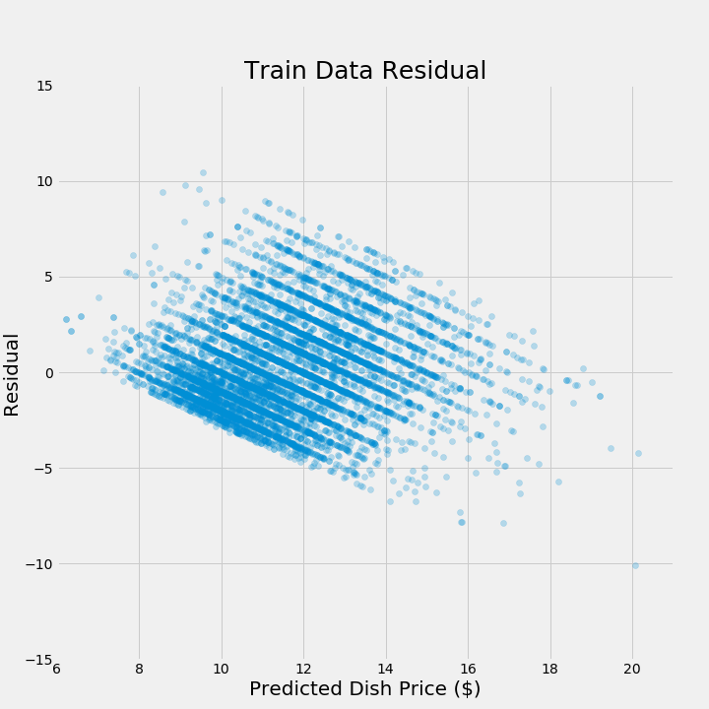
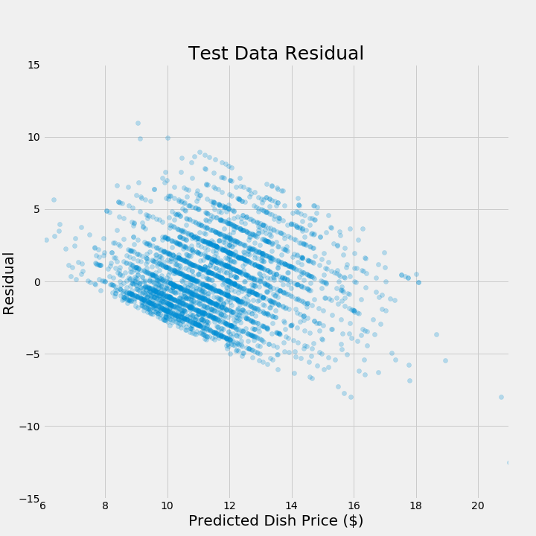
Model Performance
Train RMSE: $2.44
Test RMSE: $2.63
Notes:
Model Performance:
My final model performance on both training and test sets were similar
Distribution on the residual plots are very similar and there was only a difference of 21 cents in the RMSE so I don’t believe my model is overfitting

Slide 9
Future Work
Better suited model
High number of categorical features
Random Forest Regressor Test RMSE: $2.41
More Descriptive Features
Incorporating other cities
Notes:
Random Forest Regressor would help improve price prediction
Create better features:
Dish descriptors like fried or grilled
Capturing Multi word ingredients: goat cheese, olive oil
Brandnames: currently can’t tell the difference between Captain Morgan and Planation Rum
Time related information: different dishes require different amounts of preparation time
Model would also be more useful and indicative if we incorporate other cities, then demographic data may be a stronger predictor

Slide 10
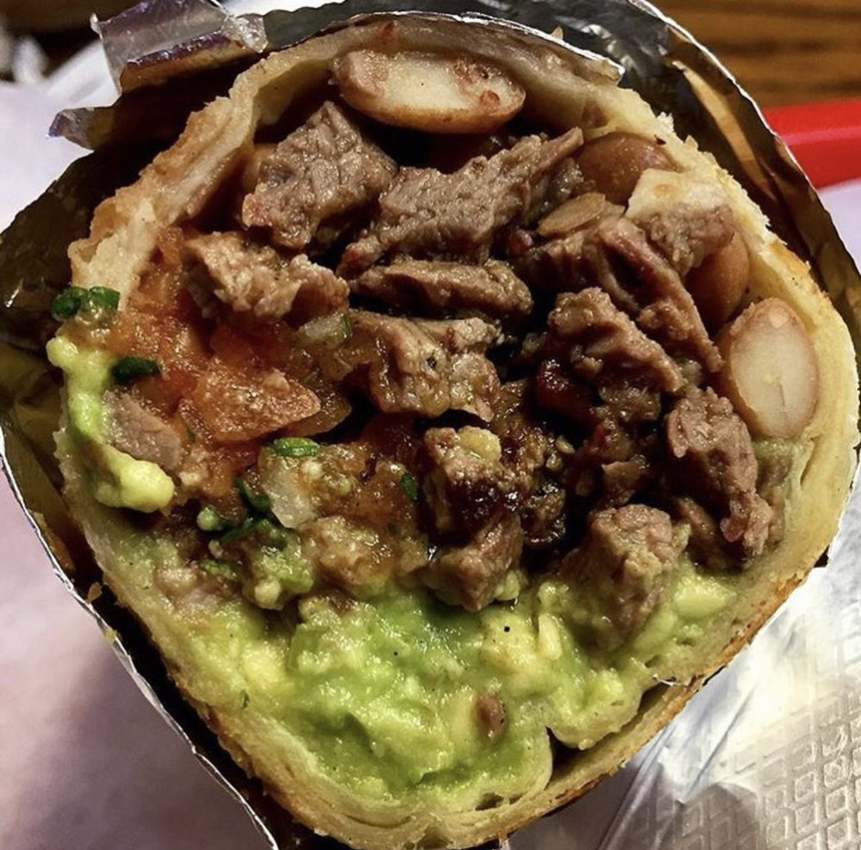
La Taqueria is the Best

